Slide 1
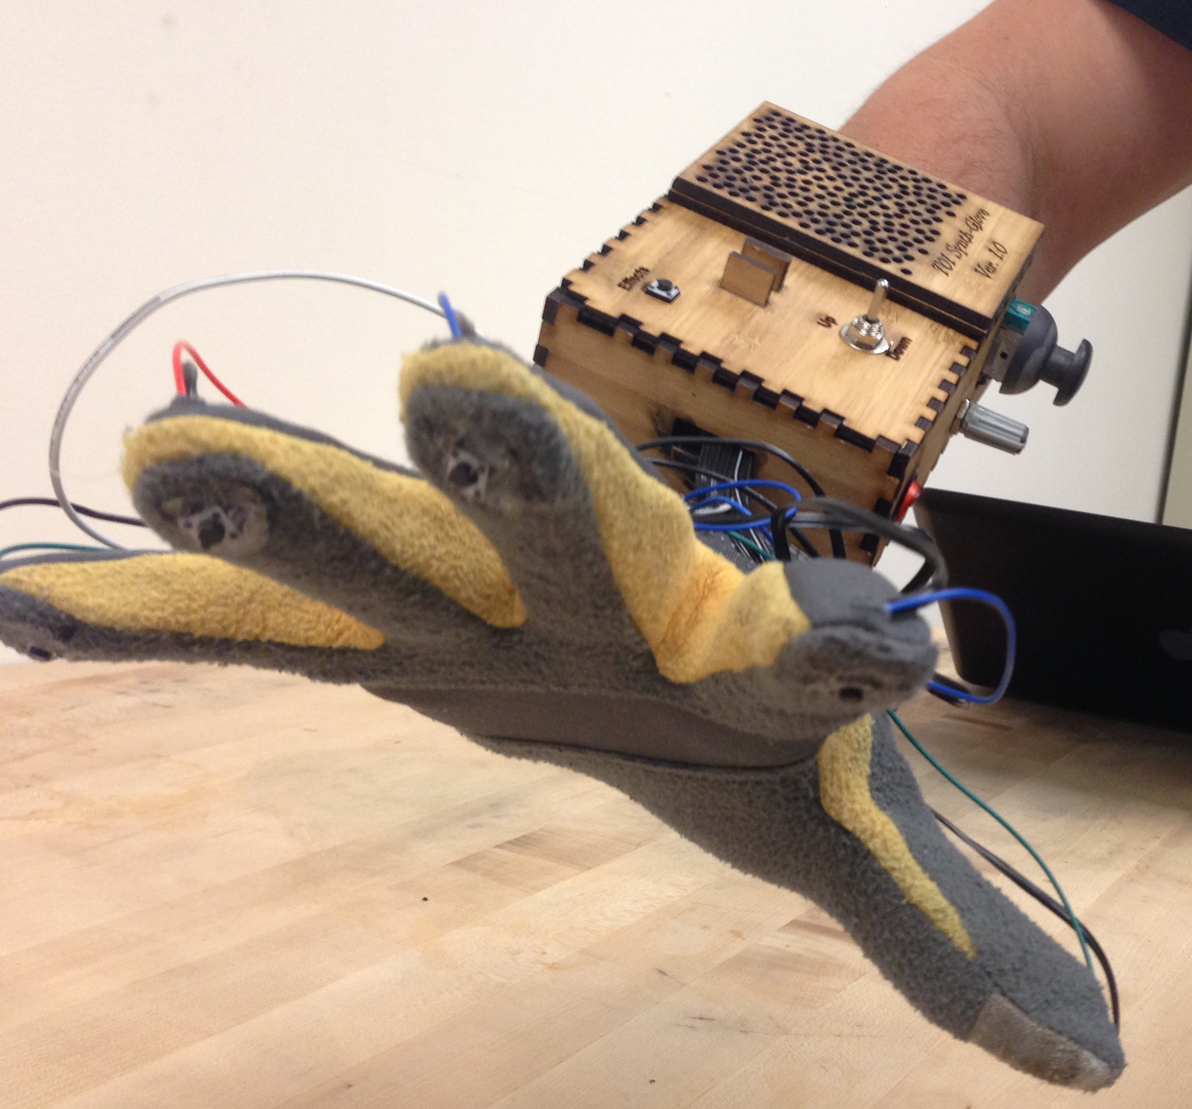
T01
Synthesizer Glove
Steve Peirce
Nicholas Sayre
Nathan Bryant
Ali Alavi

Slide 2
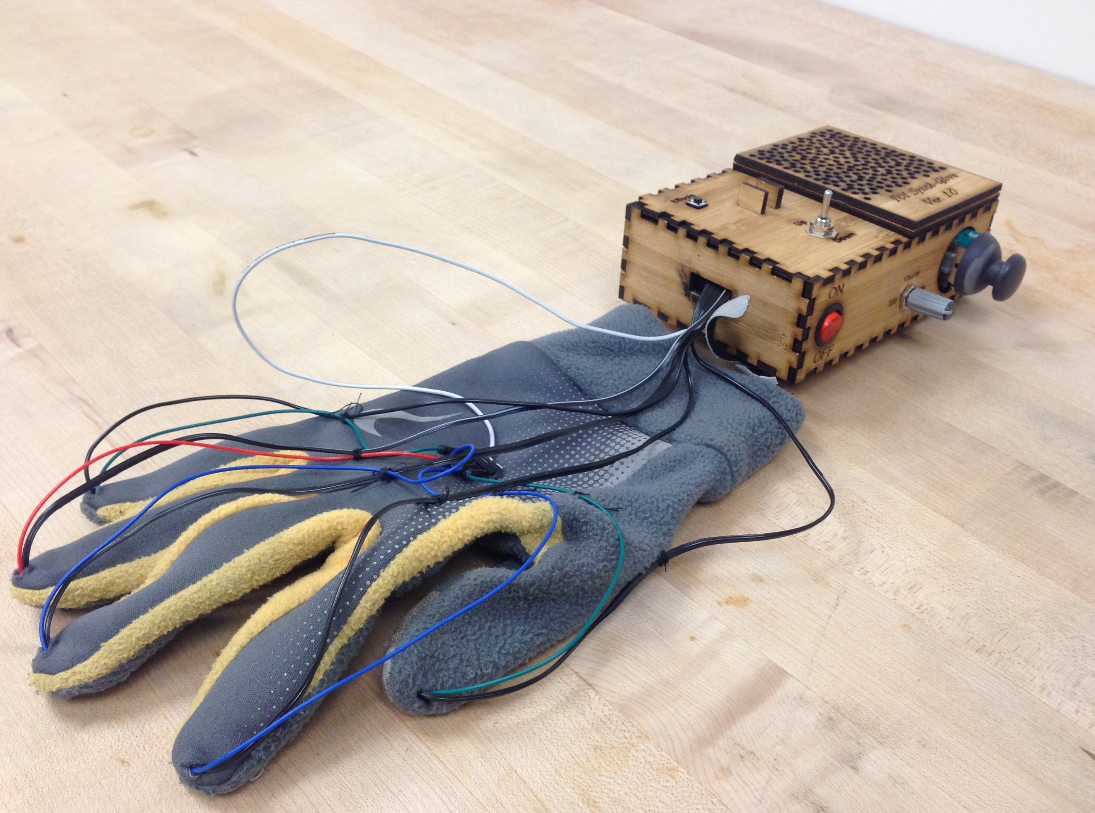
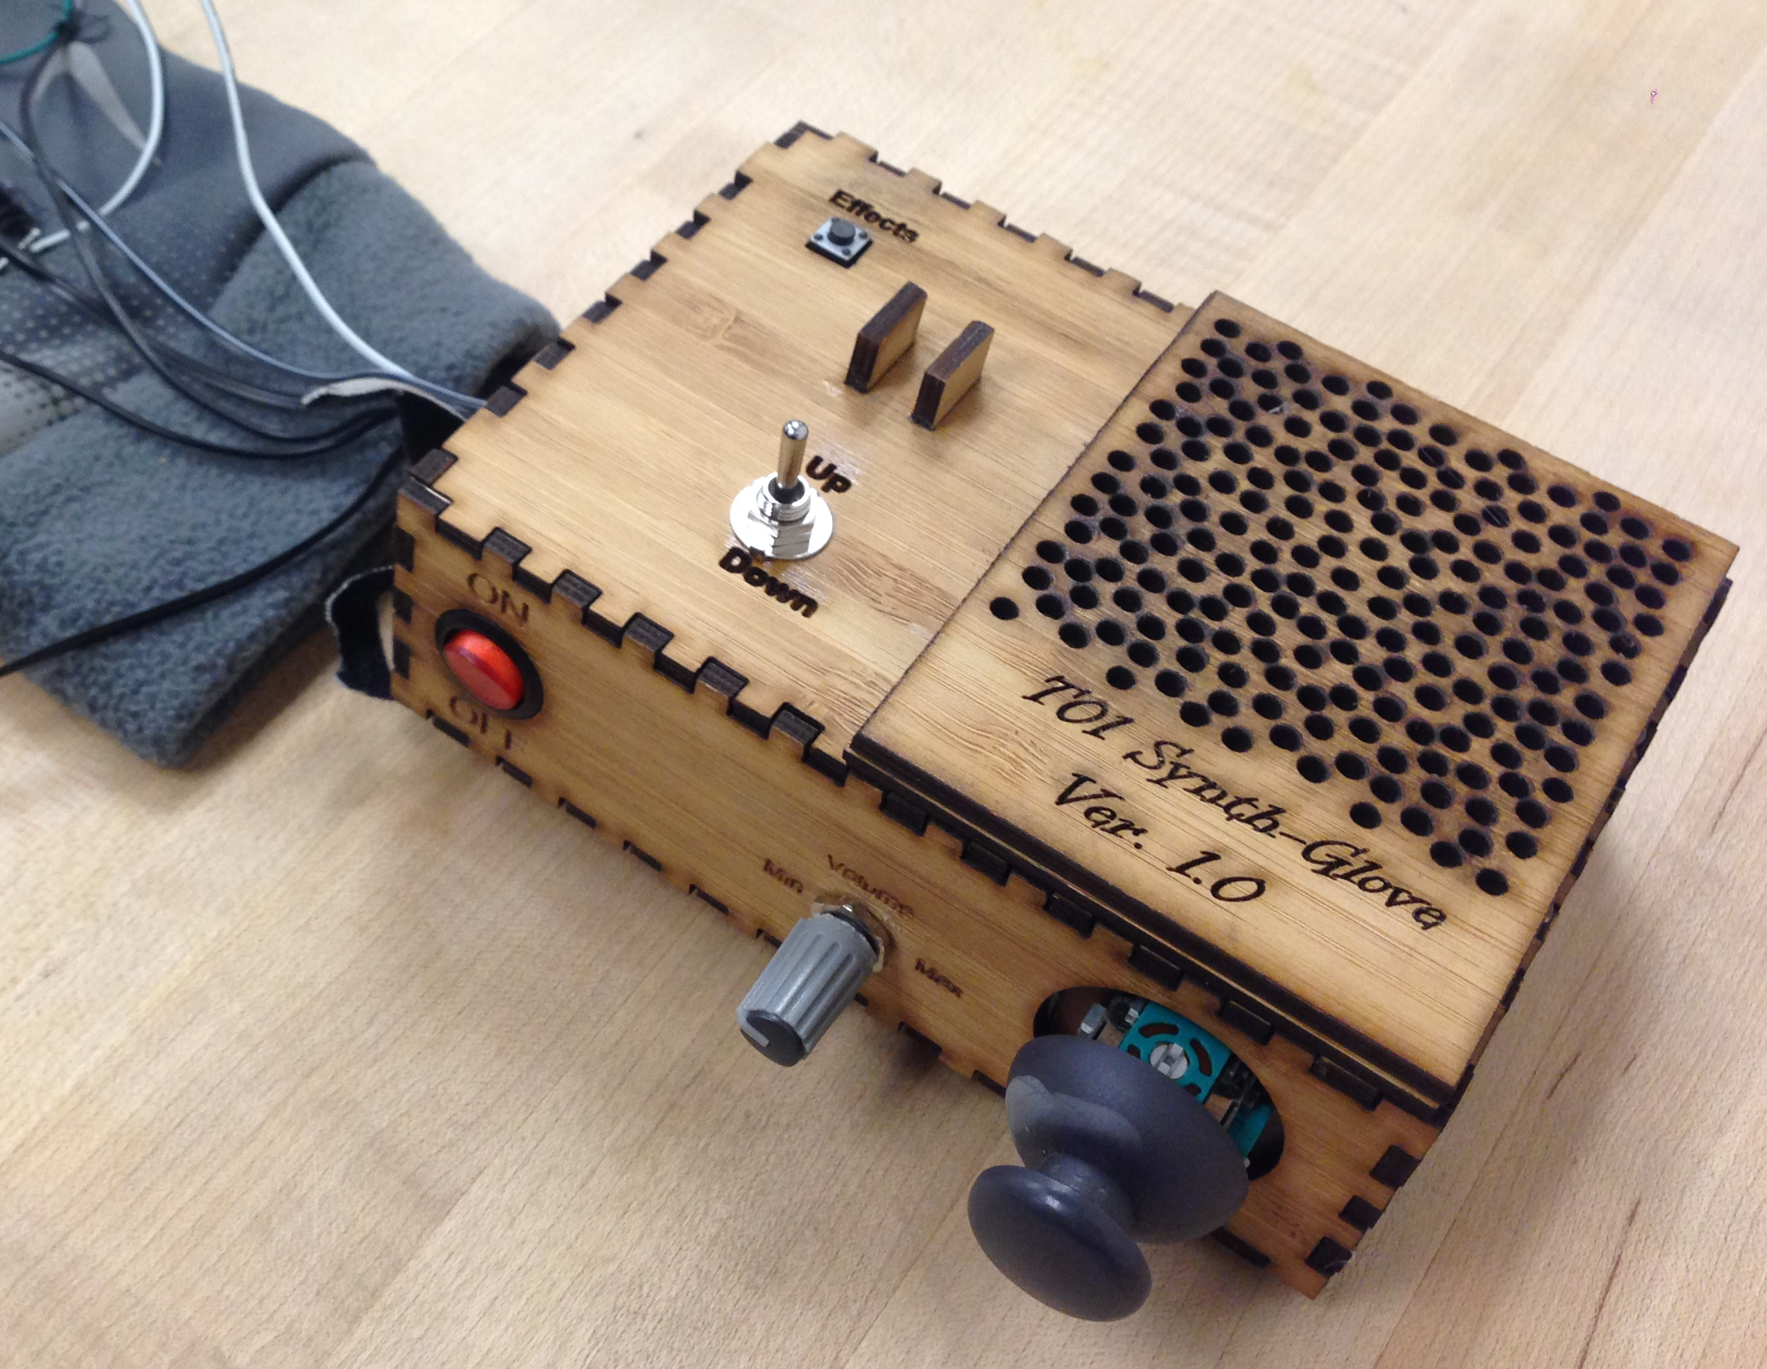
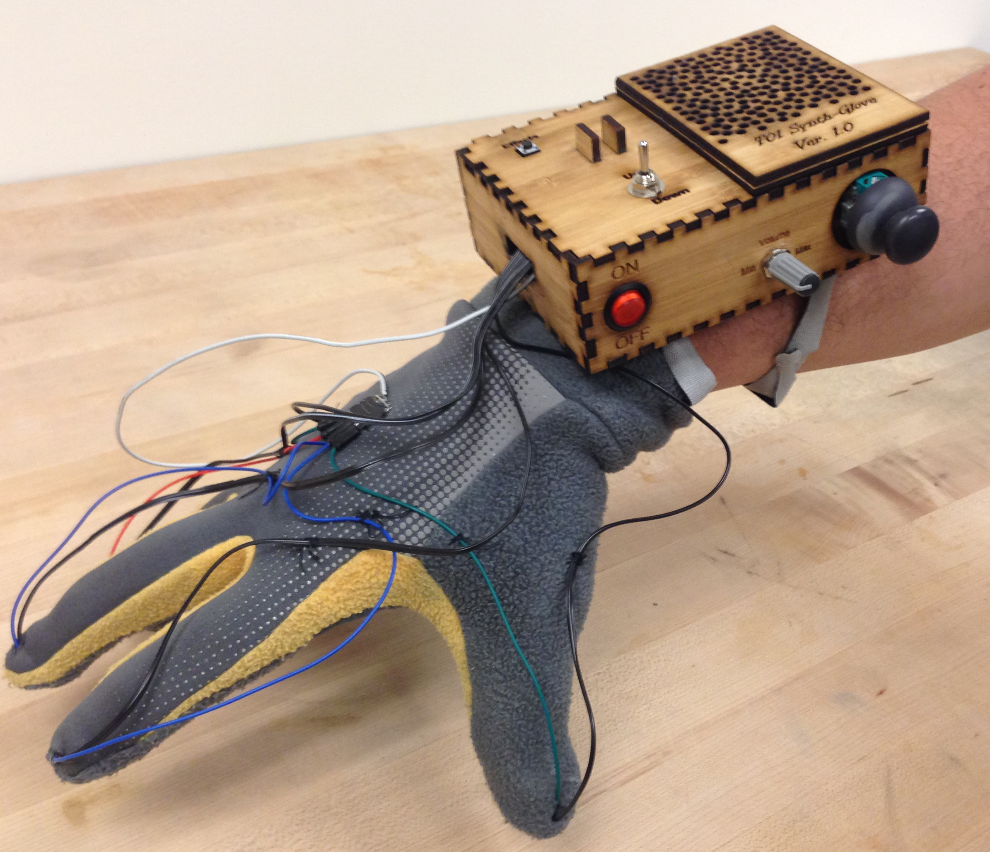
Notes:
Need: Have fun making music on the go
-wearable
-intuitive interface.
-can be played anywhere

Slide 3

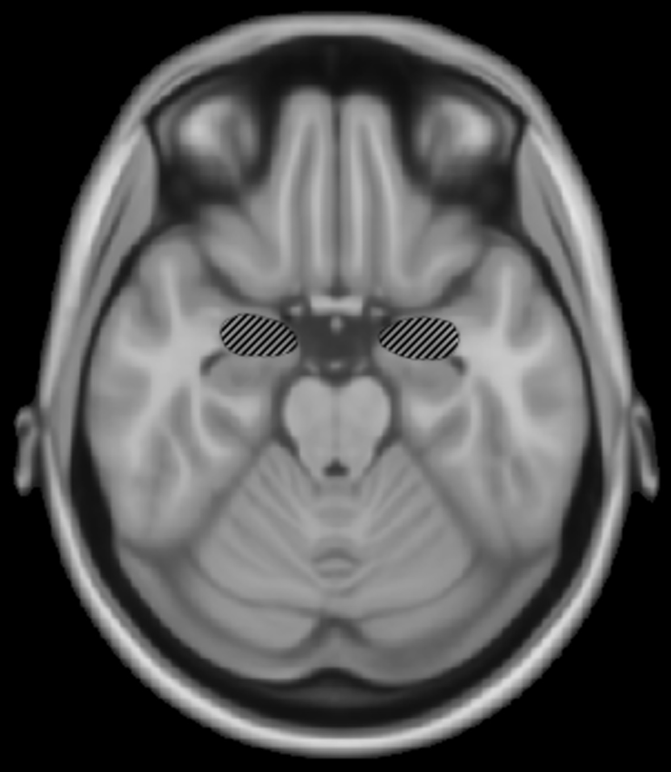
Motive
Notes:
Motivation: To promote a healthier lifestyle by reducing stress while stimulating the brain.
MUSIC
-music is used for therapy and helps reduce stress
-increases creativity

Slide 4
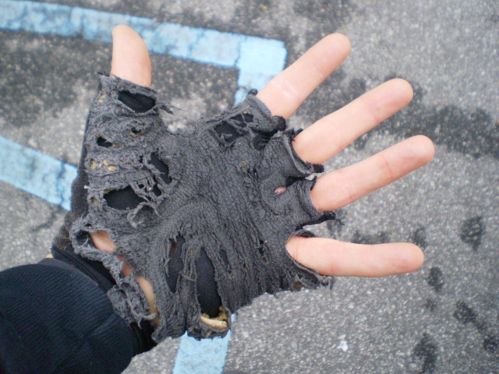
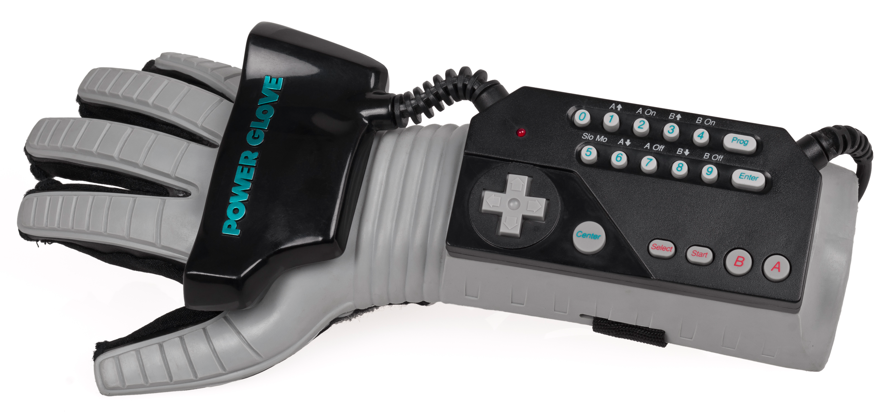
Goal
Notes:
Goal: to create a functional proof of concept which could later be adjusted by marketing for best visual design.
-wanted our prototype to function well
-how pretty the design is wasn’t a concern to us

Slide 5
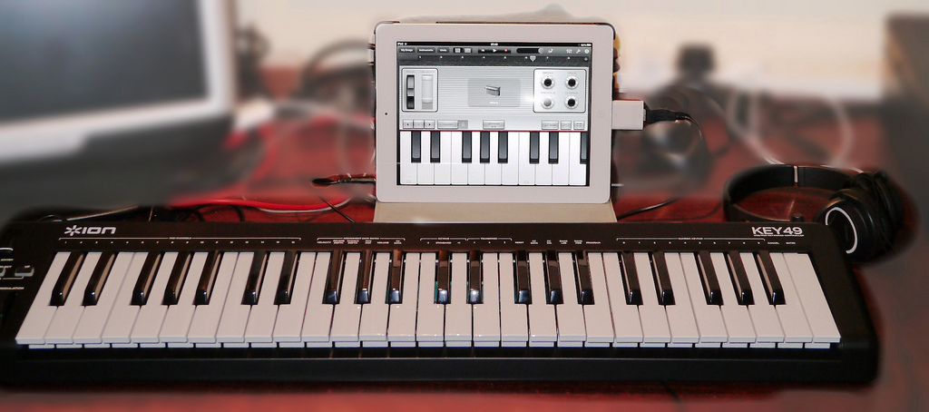
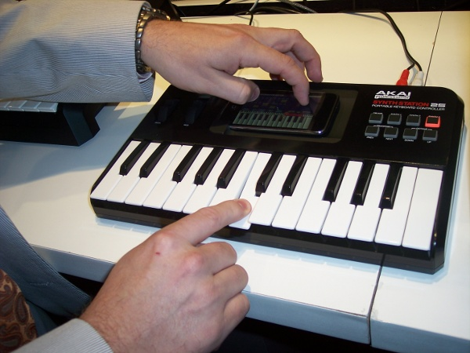
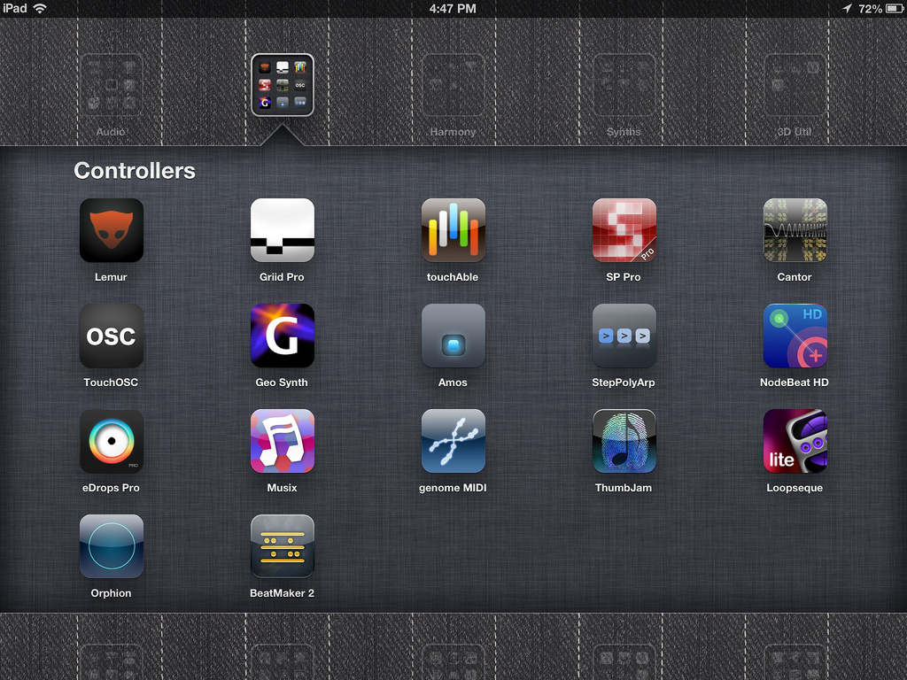
Alternatives
Notes:
Alternatives: While many nonconventional music instruments exist, most keyboards require the user to play in one place or at a station.
- None as versatile

Slide 6
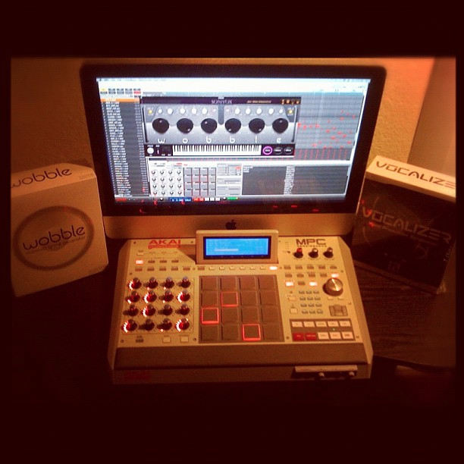
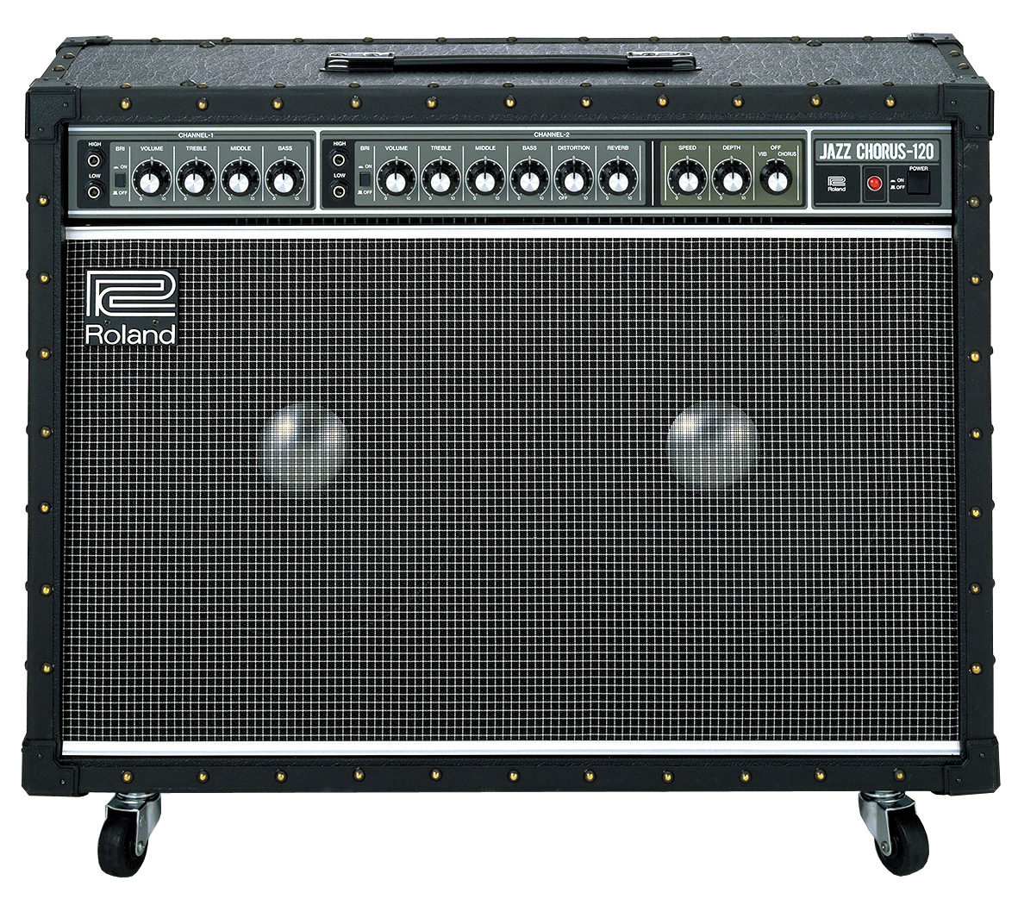
Approach
Notes:
Approach: We aimed to combine the musical versatility of a keyboard with freedom of movement while creating a new experience that inspires creativity.
Avoid bulky equipment
One single unit
Intuitive interface: what’s more intuitive than finger movement?
Wearable and easy to transport, thus glove.

Slide 7
Requirements
System will be capable of altering the produced tones based on the status of at least two sensors.
System will be battery powered and have power consumption of approximately 2.5 watts.
The system will use an inexpensive cost microcontroller to produce low resolution sounds.
System will be capable of producing tones based on finger contact.
System will be capable of producing a minimum of 5 frequencies.
System must be wearable on users hand or forearm.
Notes:
Given the focus of our project, deciding requirements were closely tied to how we conceived the physical design.
Design requirements doc here.
Justifications
finger contact:
Tone generation by finger contact is intuitive and typical for musical instruments.
2) 5 freq:
With one frequency per finger, this provides a unique frequency for each fingertip.
3) Alter tones:
Sensors like knobs, sliders, and buttons are intuitive, easy to use, and increase perception of value.
4) micro-controller:
Most low cost microcontrollers do not have analogue outputs so producing 1-bit sound as a base prevents undue reduction to development budget.
5) wearable:
Placing the system on an arm makes it accessible, portable, and easy to use.
6) power:
This makes the system loud enough to enjoy while still offering longer battery discharge times.

Slide 8
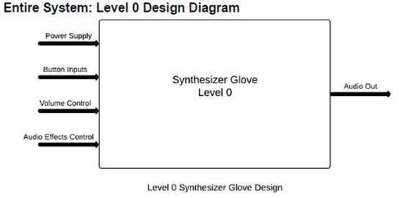
Design
Level 0
Notes:
Based on our agreed upon Requirements we concieved the system as:
UML 0
● Power: 9V DC battery
● Button inputs: Normally open momentary contact switches
● Volume control: Variable volume control
● Pitch/ tone: Variable pitch and tone control potentiometer
● Audio output: 0­9V audio signal
● Produce audio tones based on button and volume/pitch/tone control.
● Tones should be variable based on button status and audio quality should be
variable on volume/pitch/tone control status.

Slide 9
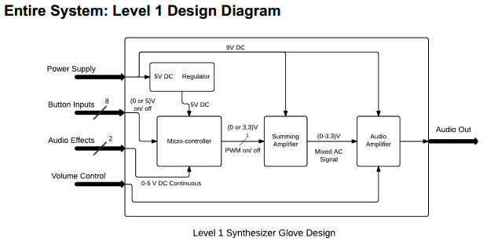
Design
Level 1
Notes:
-----------------REGULATOR--------------
Inputs:
● Power Supply: 9V battery
Output:
● DC Out: Regulated 5V DC signal
Functionality:
● The input signal enters a 9 to 5 V linear DC to DC voltage regulator.
● The signal is then smoothed using a capacitor >= 10µF.
● The signal is then filtered through a passive RC low­pass filter.
-----------------MICROCONTROLLER------------
Inputs:
● Digital 5V High: 8 total digital signals with a 5V logic high. 3 signals from the vembrace control unit, and 5 signals from the push buttons in the glove.
● 0­5V Analog: 2 analog signals ranging from 0 to 5 volts from the vambrace control unit.
● Regulated 5V DC: Regulated 5V DC voltage from the voltage regulator block for power.
Output:
● PWM Digital Out: 5 total pulse width modulated signals outputting to the summing amplifier.
Functionality:
● Produce one or two simultaneous pulse width modulated tones (PWM) based on programmed glove button pushes.
● Shift tones to the next scale up or down, programmatically assigned to the buttons on vambrace unit.
● Read two individual analog voltages based on a two axis joystick. One voltage will shift the programmed PWM tones up and down by pitch, and the other by tone.
----------------AMPLIFIER----------------
Inputs:
● Slider Position: The output of a slider potentiometer controlling the output gain of the amplifier.
● 0­3.3V Mixed AC: The 0­3.3V mixed AC output of the summing amplifier.
● 9V DC: 9V DC output of the battery for power.
Output:
● Audio Out: An amplified 0­3.3V PWM mixed AC signal.
Functionality:
● Amplifies the 0­3.3 V PWM tones produced by the microcontroller and added together by the summing amp based on the position of the slider potentiometer.
--------------SUM AMP----------------
Inputs:
● 9V DC: 9V DC output of the battery for power.
● PWM 0­3.3V Digital: up to six 0­3.3V PWM tones generated by the microcontroller.
Output:
● 0­3.3V Mixed AC: 0­3.3V mix of two PWM tones.
Functionality:
● Outputs the sum of the first two generated PWM tones produced by the microcontroller. Only two tones can be played simultaneously.

Slide 10
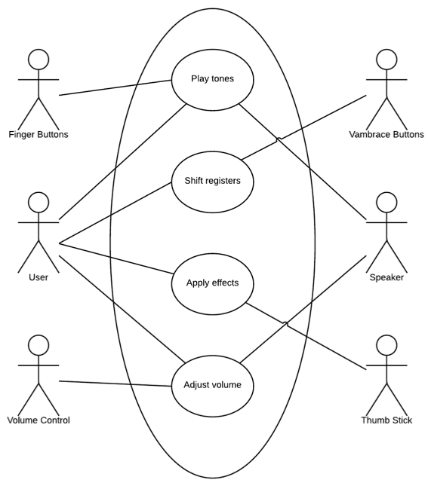
Use Case
Notes:
------------Play Tones---------------
Actors: User, Finger Buttons, Speaker
Description: User makes music with right hand playing “piano” style, in
glove.
Stimulus: User presses finger(s) onto a hard surface, forcing momentary switch at finger tip to make contact.
Response: Speaker produces multiple, scaled, PWM tones in real time corresponding to button pushes and ends tone in real time corresponding to button release.
---------Shift Registers-------------
Actors: User, Vambrace Buttons
Description: User moves current scale (pre­programed notes at fingers) up or down to the next register (continuing the scale in that direction).
Stimulus: User presses up ,or down, button on surface of Vambrace.
Response: New base tones are loaded from the tone index into the main program.
---------Apply Effects----------------
Use Case: Apply Effects
Actors: User, Thumbstick
Description: User applies pitchbend and changes tone by moving a small 2 axis joystick located on vambrace.
Stimulus: Analog voltage applied to pins in micro­controller has shifted do to positional of joystick attached to potentiometers.
Response: Output response counter is increased or decreased by up to ± 12% for one axis, and duty cycle of PWM is varied from 20­-80% (centered at 50) in response to the other axis.
---------Adjust Volume--------------
Actors: User, Volume Control
Description: User changes the audible level of the outputted sounds by changing the position of the volume control potentiometer.
Stimulus: Resistance in the feedback loop of the final amplifier changes.
Response: Gain is changed according to V_{out} = R_{feedback}/R_{in} (V_{in})

Slide 11
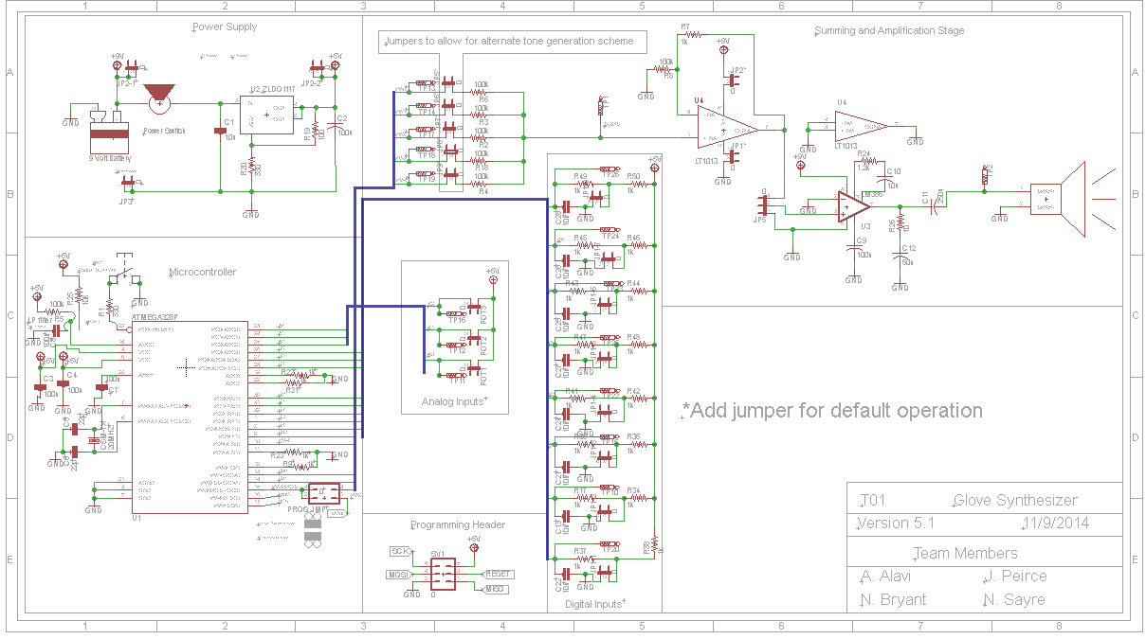
Schematic
Notes:
The interaction of button to sound was to be determined by software which meant the microcontroller was the centerpiece
Power Supply (Voltage Regulator)
Wanted to power the system with single 9V battery
Needed to have a consistent output of 5V for the microcontroller
Based on availability and shipment, we needed a chip that was as close as possible to the 7805 which we tested with
Used ZLDO1117 (cheapest that fit the bill)
Block was designed based on specs from the datasheet
Digital Inputs
- Added jumpers for 8 digital inputs
Needed to de-bounce push buttons so a low pass filter was added to each input
Post-design we discovered specific de-bounce circuits outlined by Atmel for the ATMEGA chip
Analog inputs
Added jumpers for 3 total analog inputs
Microcontroller
Configured for 20 MHz clock using a crystal oscillator
Added a programming jumper to an input/output so that we could program or output from the same pin
Followed design considerations outlined by the datasheet, ensuring we make adjustments for maximum output
Programming Header
Program header device model was the wrong one and so the pins were set up incorrectly
Jumpers for alternate tone generation
5 jumpers were added for a potential alternate tone generation technique
This technique would have integrated 5x 555 timers connected to caps and digi-pots
Microcontroller would have adjusted the values of the digi-pots
This was done not just as a contingency plan, but also to allow freedom to modify the design for hobbyists
Summing Stage
A summing amplifier (LT1013) is used to combine two tones so they can be played simultaneously
Amplification Stage
The summing amp then outputs to an amplification stage which attenuates down to 0 and gives a gain of up to 26 dB based on our potentiometer value.
After finding our parts list we created the modified version and began board layout which lead to (next slide)

Slide 12
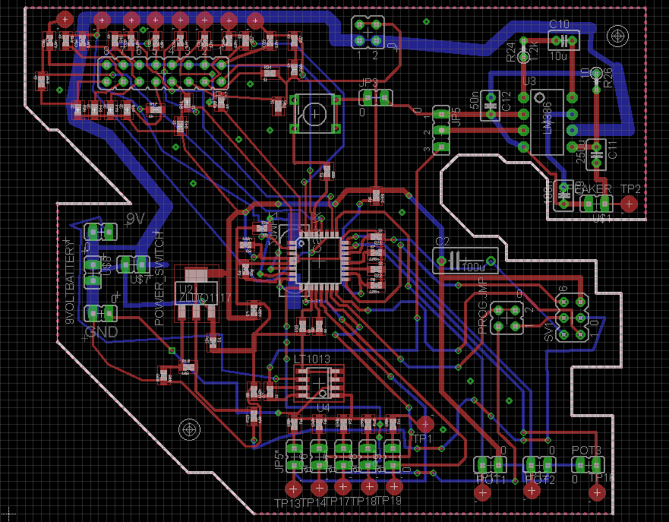
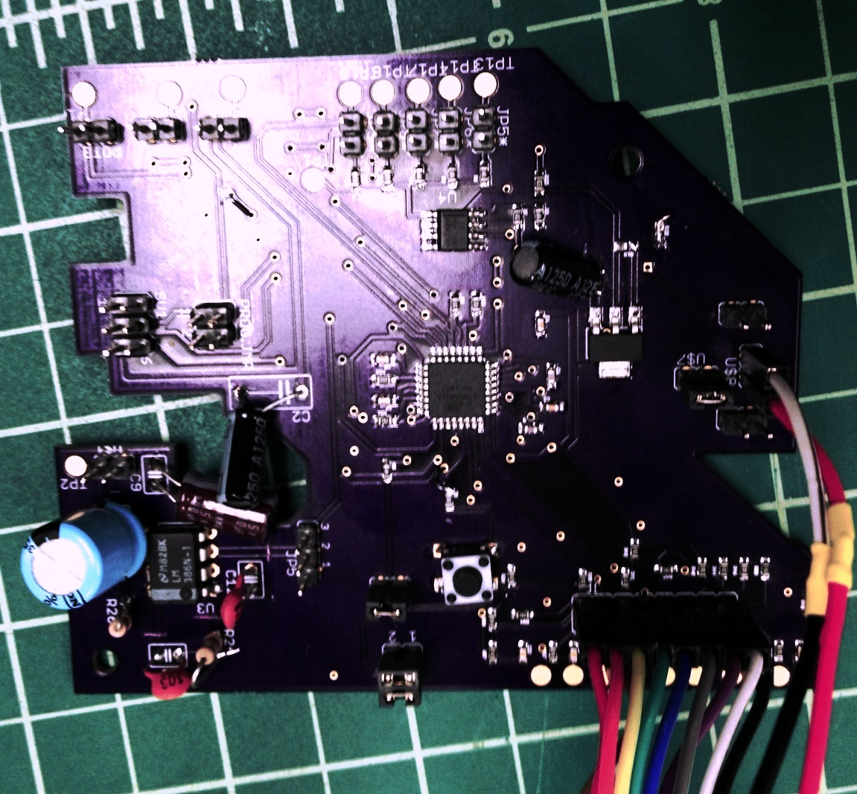
PCB
Layout

Slide 13
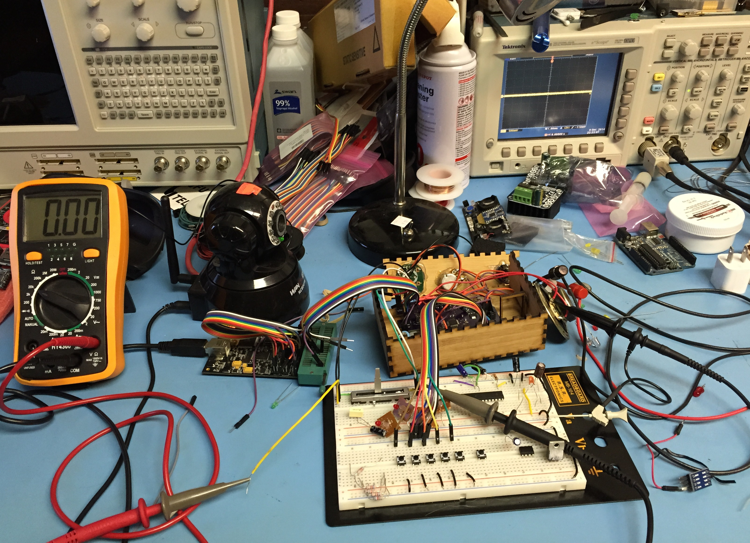
Programming
Notes:
Port Definitions(I/O)
Initialization sequence
PWM init (reg. specfic)
set initial tones with frequencies and all the register settings to modify based on effects
ADC init (reg specifiic)
Enable Global Interrupts
Begin First ADC conversion
Drop into main while(1)
Wait for update flag from button ISR(s)
ADC ints happen in background @ ~ 200KHz
Call PWM update → which button/which tone
PWM output → modifiers(effects)/enables PWM clocks(XOR)
Set Update → false
Return to wait loop

Slide 14
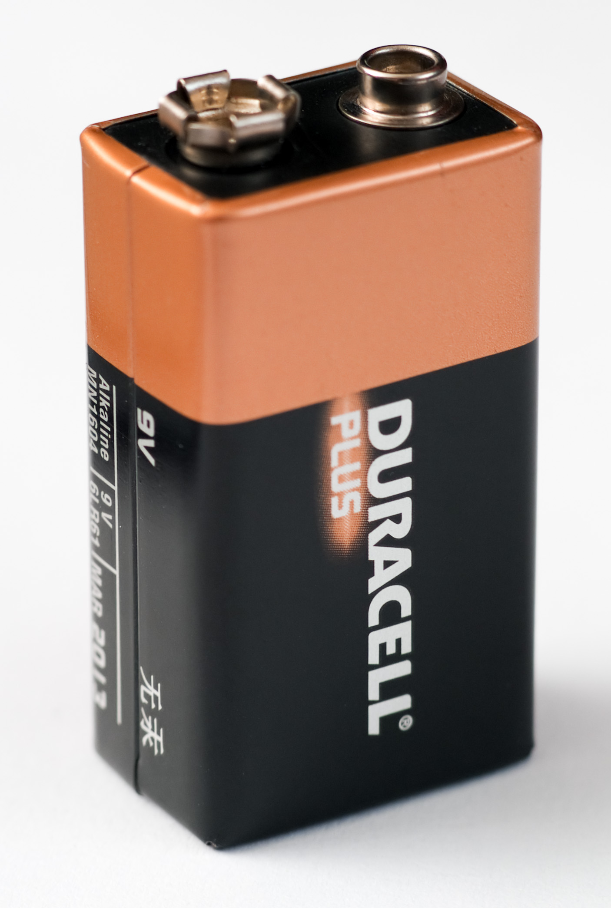
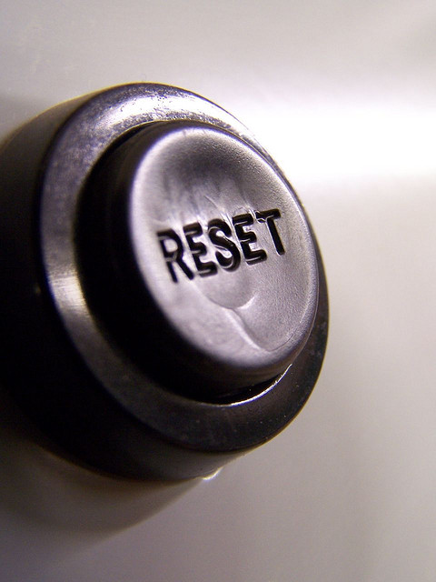

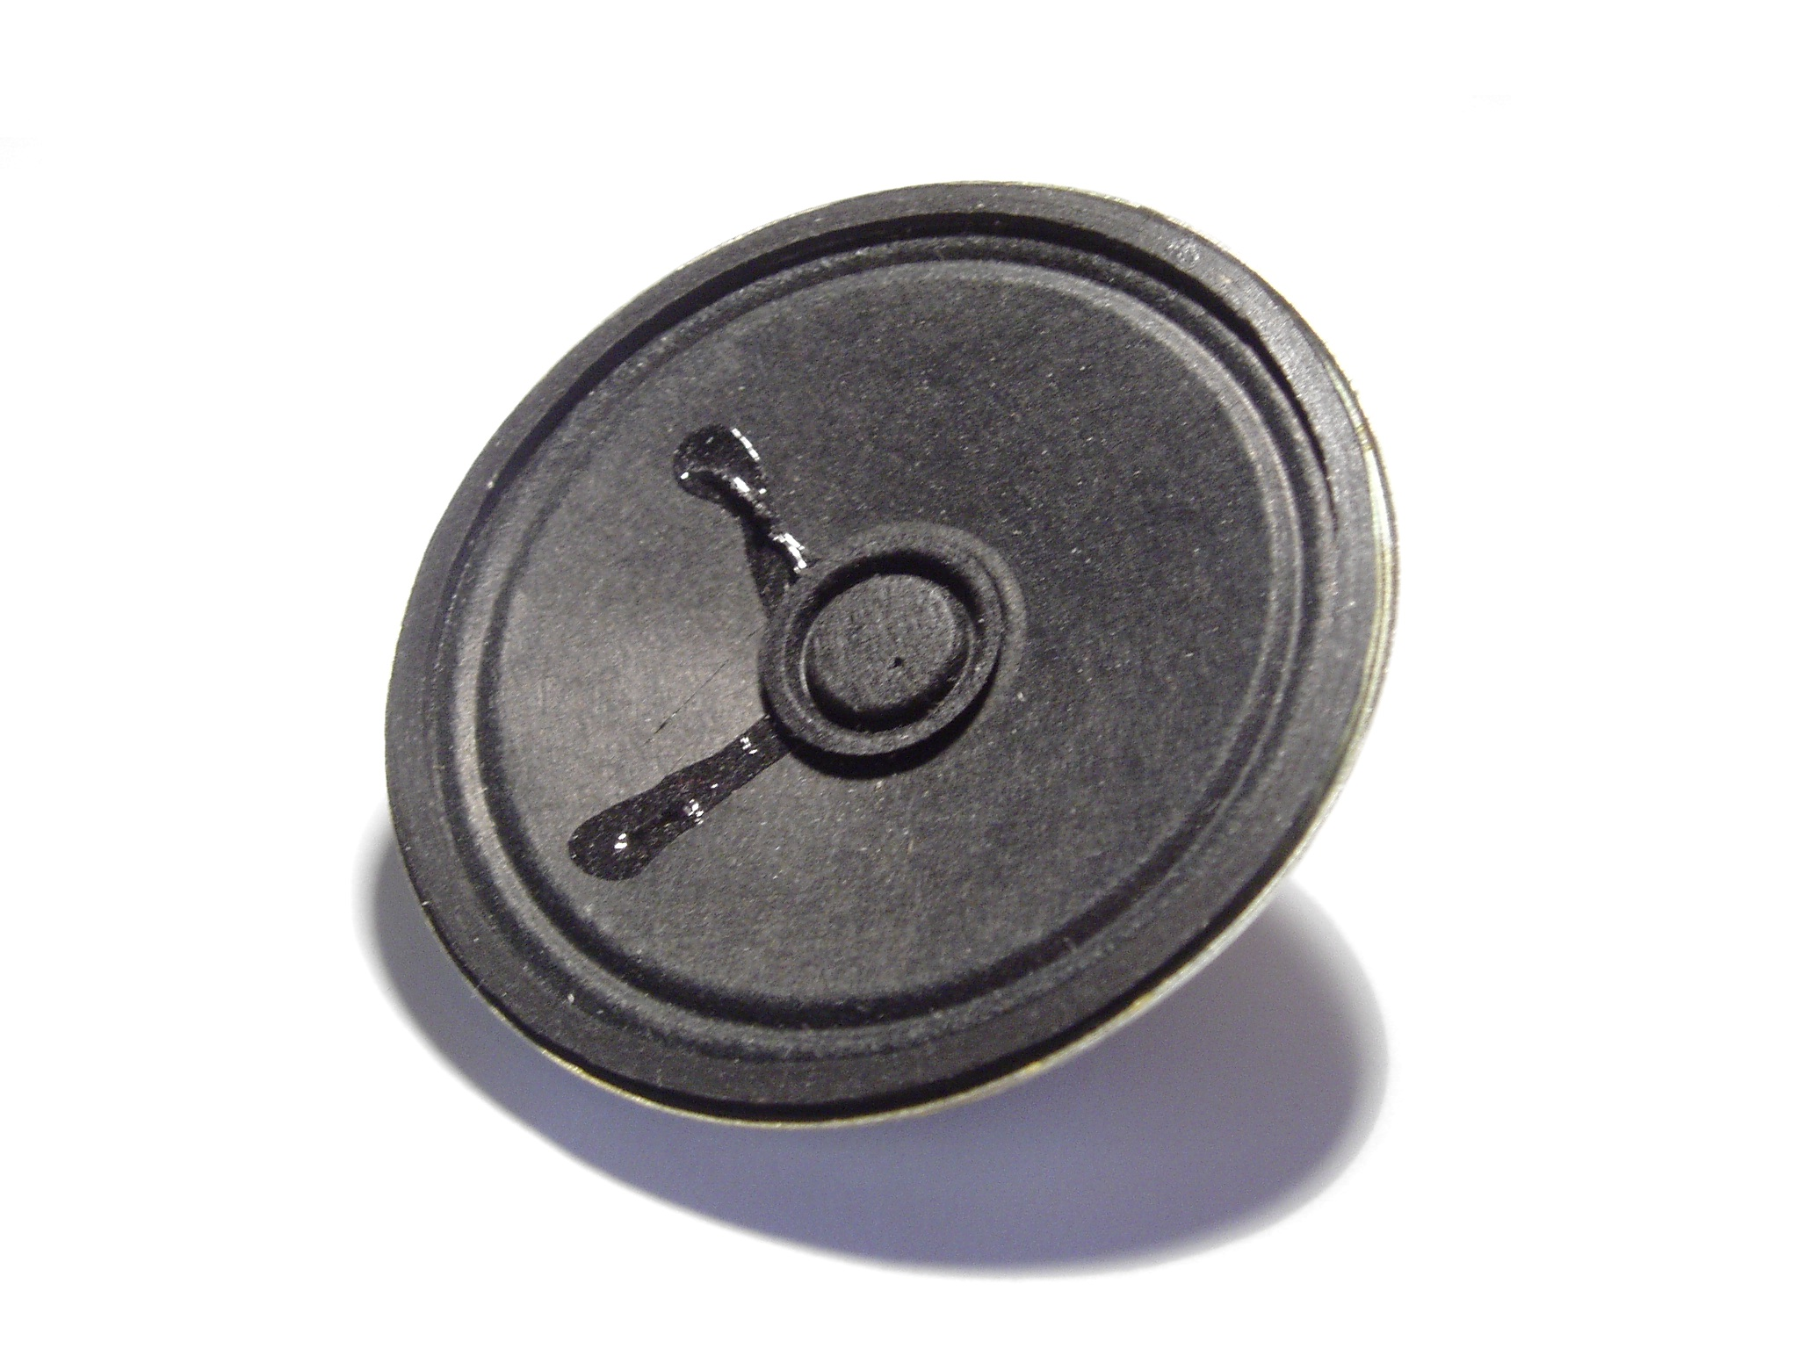
Testing
Programming
Notes:
Testing proved to be problematic. Pressure on team members and sequence of returns limited our ability to integration and white box testing.
Issues
Voltage regulator block was incorrectly configured and was outputting approximately 7.5 V so it had to be adjusted accordingly
Reset pin didn’t make it out to the chip so we had to jump a node to the reset pin on the microcontroller
Amplifier configuration was wrong so we had to cut the paths and run jumpers from the pins to the correct path
code
Got together, ordered pizza, and started brainstorming and running through the code

Slide 15
Contributions
Ali | Nathan | Nick | Steve
Research | Research | Research | Research
Proposal | Proposal | Proposal | Proposal
Design Requirements | Design Requirements | Design Requirements | Test Programs
Prototype Board Assembly | Schematic | Schematic | Write Program
Project Schedule Draft+Revise | PCB Layout | PCB Layout | Revise Program
System Diagrams | Project Schedule Review | Prototype Board Design and Assembly | Finalize Program
Housing | System Diagrams | System Diagrams | Testing
Prototype Assembly | Test Plan | Housing
Testing | Housing | PCB assembly
Presentation | PCB assembly | Prototype Assembly
 | Prototype Assembly | Testing
 | Testing

Slide 16
Intellectual Property
Lessons Learned
Notes:
Intellectual property → Rc ladder, Arduino, synth
→ 555 ladder + midi
→ ended up doing it our own way
Lessons Learned:
What did we all learn?
What would you do differently?

Slide 17
Questions?
Notes:
Q/A

